Slide 1



Crops and Fertilizers
Recommandation system using ML

Slide 2

Learning Objectives
Understand the use of machine learning in agricultural systems.
Learn how to use libraries like Pandas, NumPy, Seaborn, and Matplotlib
Learn about data preprocessing, feature engineering, and model evaluation.
Gain hands-on experience with Scikit-learn for machine learning.
Explore the basics of decision tree classifiers for prediction.
GOAL
Source :
www.freepik.com/

Slide 3
Tools and Technology used
Python – Primary programming language for implementing machine learning models.
Pandas – Used for data manipulation and analysis.
NumPy – Helps with numerical operations and array handling.
Seaborn – For data visualization (plotting graphs to understand data patterns).
Matplotlib – Used for creating static, interactive, and animated visualizations.
Scikit-learn – Machine learning library for implementing algorithms like decision trees, classification, and regression.
Jupyter Notebook – Environment for interactive coding, testing, and documentation of the project.
VS Code – Integrated Development Environment (IDE) for Python development.

Slide 4
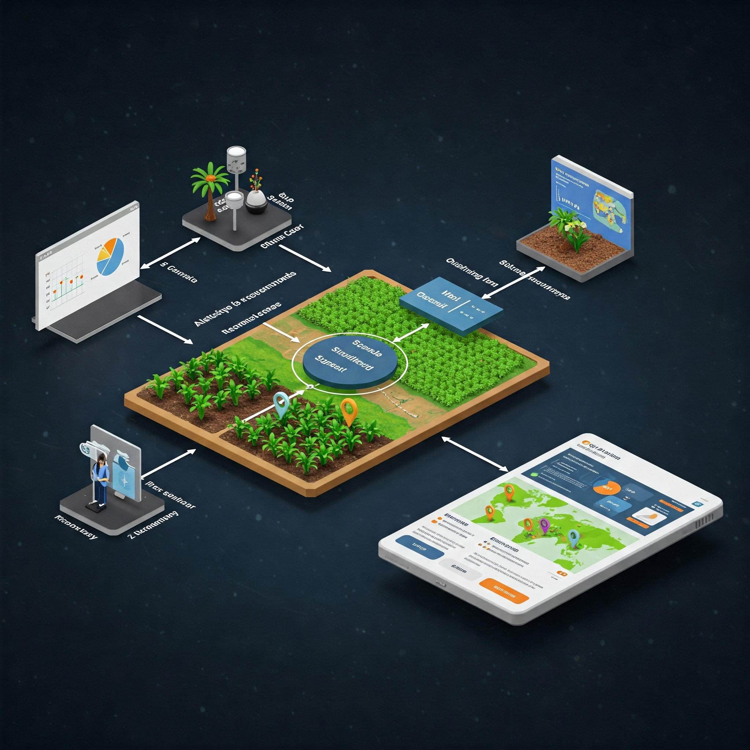
Methodology
Data Collection:
Collected agricultural data such as climate, soil type, and crop yield.
Data Cleaning:
Cleaned the data by fixing missing values and errors.
Data Visualization:
Used graphs to understand patterns in the data.
Feature Engineering:
Created important features like soil type and location for the model
Model Training:
Used Decision Tree Classifier to train the model on the data.
Model Evaluation:
Tested the model to check its accuracy.
Outcome:
The model recommends the best crops based on input factors.

Slide 5
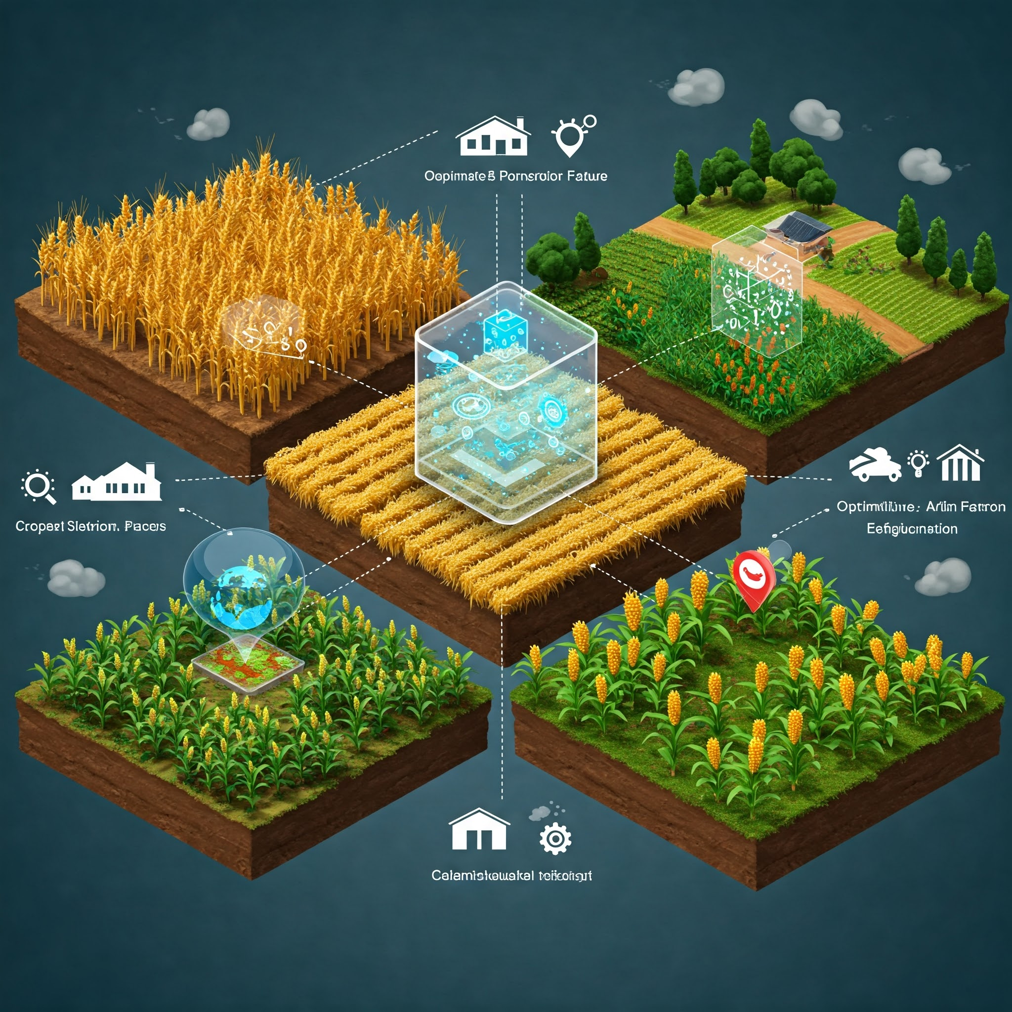
Problem Statement:
Farmers face challenges in selecting the right crops to grow based on varying factors like climate, soil conditions, and geographical location. The goal of this project is to develop a machine learning-based crop recommendation system that can suggest the most suitable crops for specific regions by analyzing these factors, helping farmers improve crop yield and efficiency.

Slide 6
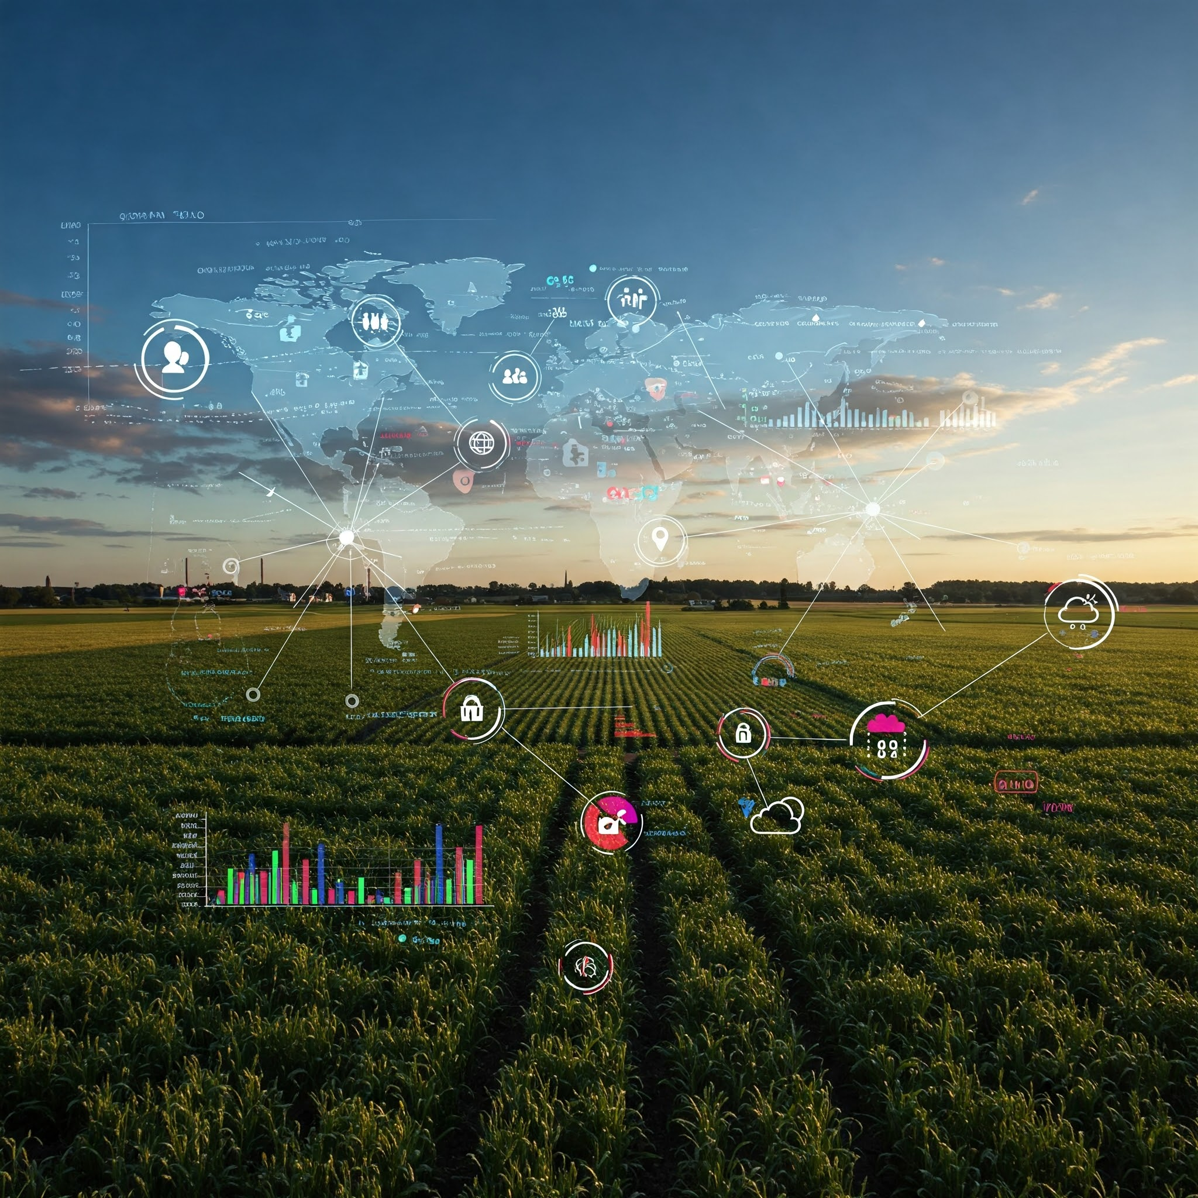
Solution:
The Agriculture Prediction App integrates machine learning algorithms to provide actionable insights for farmers. The app offers two key functionalities:
1. Prediction Type Selection:
i) Crop Prediction: The app allows users to determine the best crop to cultivate based on the input parameters provided.
ii) Fertilizer Prediction: Offers suggestions for fertilizers tailored to the soil and crop needs to enhance productivity.
2. Input Fields:
i) Nitrogen (N), Phosphorus (P), and Potassium (K): Users enter values representing the soil's nutrient content. These nutrients are crucial for plant growth and yield.
ii) Additional factors such as temperature, humidity, and rainfall may also be included in future iterations to enhance prediction accuracy.

Slide 7
Solution:
3. Output Insights:
i) After entering data and selecting the prediction type, the app processes the input through trained machine learning models.
ii) Result: Displays the recommended crop and fertilizer in a user-friendly format, empowering users to make informed decisions.
Significance of the Output:
i) For Farmers: Provides actionable insights that directly enhance agricultural efficiency, reduce costs, and optimize resources.
ii) For Agricultural Stakeholders: Enables better planning and resource allocation to achieve sustainable farming practices.

Slide 8
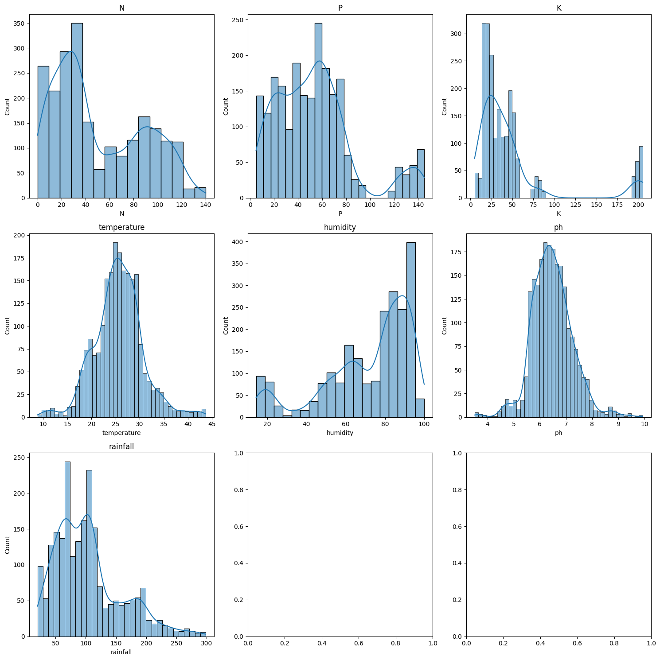
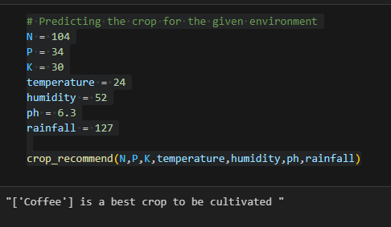
Screenshot of Output:

Slide 9
Conclusion:
Machine learning plays a transformative role in agriculture by providing data-driven insights for better crop management and resource utilization. The Crop and Fertilizer Recommendation System developed in this project highlights the potential of integrating technology in agriculture
.
Enhanced Decision-Making: By analyzing soil nutrients and environmental factors, the system assists farmers in selecting optimal crops and fertilizers.
Scalability: The model is built to handle diverse agricultural data and can be adapted for various geographical regions.
Streamlit Integration: The use of Streamlit for the interface ensures a user-friendly experience, enabling seamless interaction and real-time recommendations.
Future Enhancements: The system can incorporate additional features such as pest management, weather forecasting, and market price predictions to further support farmers.
Sustainability: Promotes efficient use of fertilizers and resources, contributing to sustainable farming practices.
This project demonstrates the potential of AI and machine learning in revolutionizing traditional farming techniques and driving agricultural innovation

